Slide 1
Course No: CSE 4255 Course Title: Telecommunication Lecture 1: Introduction to Telecommunication
Tanvir Ahmed
Assistant Professor
Dept. of CSE, AUST

Slide 2
Course Objective:
The objective of the course is to give an introduction to the telecommunications, fundamentals of wireless communication system, the wireless network architectures and protocols. Topics of study includes an overview of wired telephony system; switching technique; wireless telecommunication system; cellular telephony; GSM; signal propagation models; fading in the mobile environment; multiple access techniques; modulation techniques; satellite communication and wireless networking standards IEEE-802.11.

Slide 3
Text Books
Wireless Communications and Networks; 2nd edition---William Stallings
Wireless Communications Principles and Practice; 2nd edition---T. S. Rappaport

Slide 4
Grading:
Class Performance: 10%
Quiz: 20%
Final: 70%

Slide 5
What is telecommunication?
Communication is the sharing of information or messages between two or more entities.
The word tele is Greek for "far off".
The term telecommunication, means communication at a distance.
The information may be in the form of voice, video, and data:
Voice telecommunication - using electrical signals to transmit human voice across a distance, such as telephones and radio broadcasts.
Video telecommunication - the electrically-based transmission of moving pictures and sound across a distance.
Data telecommunication - the use of electrical signals to exchange encoded information between computerized devices across a distance.

Slide 6
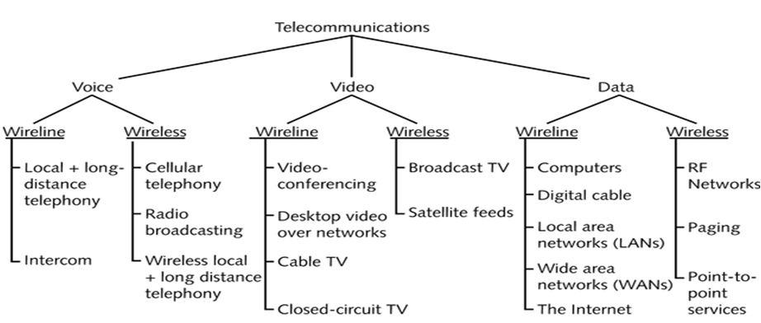
Types of Telecommunication Services

Slide 7
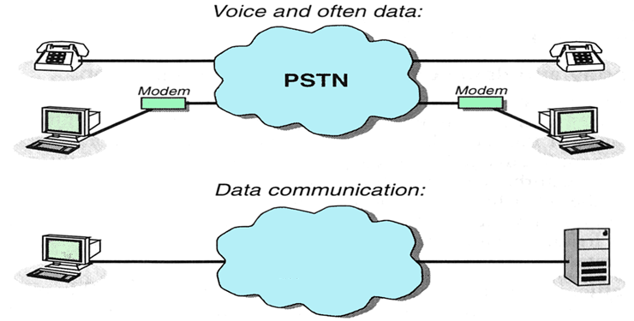
Data and Voice Networks
Divided networks
Internet
Voice telecommunication or Switched Telephone Network – PSTN, ISDN (integrated services digital network), GSM
Data telecommunication or Computer (data) networks – Internet, WLAN,

Slide 8
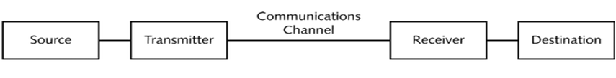
Elements of Telecommunication System
Source - the originator of the message, whether it is a person or machine.
Transmitter - the equipment that modifies the message (either data or voice) into the form required for transmission.
Communications channel - the means of carrying the signal from the source to the destination.
Transmission media - may be physical, like a copper wire or fiber optic cable, or atmospheric, like radio waves.
Receiver - is the device that captures the message from the communications channel and converts it into a form that the person or machine at the destination can understand.
Destination - the person or machine to whom the message is directed

Slide 9
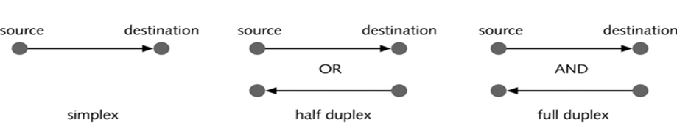
Transmission Modes
Signals can be transmitted though telecommunications media in a number of different ways:
In simplex transmission, data can flow only in one direction
In half-duplex transmission, data can flow in both directions but it can only flow in one direction at any point in time
In full-duplex transmission, data can flow in both directions at the same time
Frequency-division duplex (FDD) 
Time-division duplex (TDD): simulated full-duplex

Slide 10
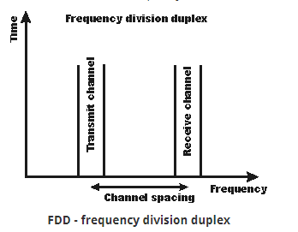
FDD
Frequency-division duplexing (FDD) is a method for establishing a full-duplex communications link that uses two different radio frequencies for transmitter and receiver operation.
The transmit direction and receive direction frequencies are separated by a defined frequency offset (guard band).

Slide 11
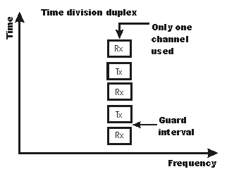
TDD
Time-division duplexing (TDD) is a method for emulating full-duplex communication over a half-duplex communication link.
TDD divides a data stream into frames and assigns different time slots to forward and reverse transmissions, thereby allowing both types of transmissions to share the same transmission medium.
TDD schemes require a guard time or guard interval between transmission and reception.

Slide 12
Related Terminologies
Bandwidth in hertz, refers to the range of frequencies in a composite signal or the range of frequencies that a channel can pass.
Data Rate in bits per second, refers to the number of bits per second that a channel, a link, or even a network can transmit.
Throughput is the actual amount of data that is successfully sent/received over the communication link.
Latency (Delay) defines how long it takes for an entire message to completely arrive at the destination from the time the first bit is sent out from the source.
Latency = propagation time + transmission time + queuing time + processing delay.
Notes:
Throughput: For example, we may have a link with a bandwidth of 1 Mbps, but the
devices connected to the end of the link may handle only 200 kbps. This means that we
cannot send more than 200 kbps through this link.

Slide 13
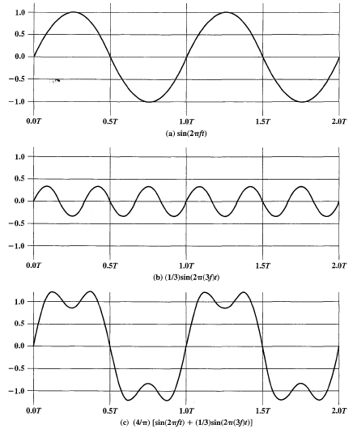

Data Rate and Bandwidth
Suppose:
Positive pulse → binary 0
Negative pulse → binary 1
Duration of each pulse is 1/2f
Data rate is 2f bps
If more frequencies are added to the signal then the wave form approaches to the square wave
The frequency components of the square wave with amplitude A and –A can be expressed as follows :

Slide 14
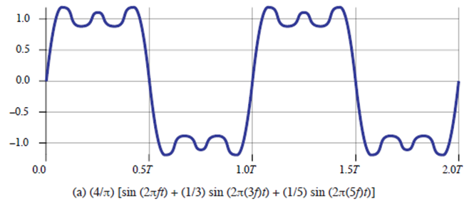
Data Rate Calculation
Case 1: Figure a
Let f = 10⁶ cycles/sec = 1 MHz
Frequency components = 1f, 3f, 5f
Bandwidth = 5f – f = 4f = 4 MHz
T = 1/ 10⁶ ⁼ 10⁻⁶ = 1μs
If we treat this wave form as bit string of 1s and 0s, 1 bit occurs at every 0.5 μs, i.e duration of each pulse is 1/2* 10⁶
Data rate = 2 * 10⁶ = 2Mbps
Thus for 4 MHz BW data rate is 2 Mbps

Slide 15
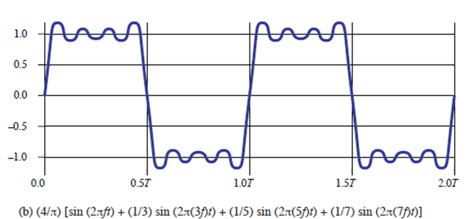
Data Rate Calculation
Case 2: Figure b
Let f = 2*10⁶ cycles/sec = 2 MHz
Frequency components = 1f, 3f, 5f
Bandwidth = 5f – f = 4f = (5*2*10⁶ - 2*10⁶ ) = 8 MHz
T= 1/ 2 *10⁶ = 0 .5 μs
If we treat this wave form as bit string of 1s and 0s, 1 bit occurs at every 0.25 μs i.e duration of each pulse is 1/4* 10⁶
Data rate = 4* 10⁶ = 4Mbps
Thus for 8 MHz BW data rate is 4 Mbps

Slide 16
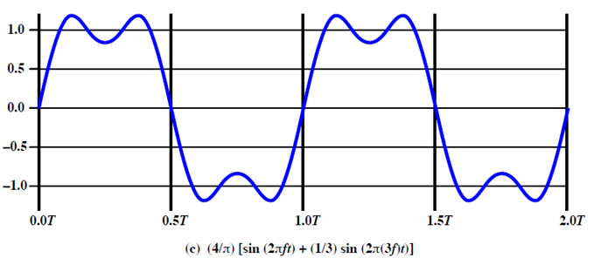
Data Rate Calculation
Case 3: Figure c
Let f = 2*10⁶ cycles/sec = 2 MHz
Frequency components = 1f, 3f
Bandwidth = 3f – f = 2f = (3*2*10⁶ - 2*10⁶ ) = 4MHz
T= 1/ 2 *10⁶ = 0 .5 μs
I f we treat this wave form as bit string of 1s and 0s, 1 bit occurs at every 0.25 μs i.e. duration of pulse is 1/4* 10⁶
Data rate = 4* 10⁶ = 4Mbps
Thus for 4 MHz BW data rate is 4 Mbps

Slide 17
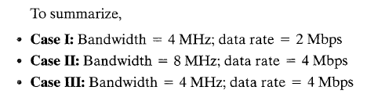
Data Rate Vs Bandwidth
Bandwidth ↑
Data rate ↑ (compare case 1 and 2)
Same signal quality
Same bandwidth
Higher signal quality → lower data rate
Compare case 1 and 3
Same data rate
Bandwidth ↑ → better signal quality
Compare case 2 and 3

Slide 18
Data Rate Vs Bandwidth
Same signal quality (Compare case 1 and 2)
Bandwidth ↑
Data rate ↑
Same bandwidth (Compare case 1 and 3)
Higher signal quality → Lower data rate
Lower signal quality → Higher data rate
Same data rate (Compare case 2 and 3)
Bandwidth ↑
Higher signal quality

Slide 19
Channel Capacity
The maximum rate at which data can be transmitted over a given communication path, or channel, under given conditions.
Impairments, such as noise, limit data rate that can be achieved.
Nyquist Formula is: C = 2B log₂M
Shannon Capacity Formula is: C=B log₂(1+SNR)

Slide 20
Signal to Noise Ration
Signal to noise ratio (SNR) = power of signal/power of noise
Typically measured at the receiver
SNR_{db}⁼10 log₁₀ (signal/noise)
A high SNR means a high quality of signal

Slide 21
Example 1:
Lets consider the spectrum of a channel is between 3 MHz and 4 MHz and SNR_{db} =24 dB. Then find the maximum capacity achieved by channel. If it is possible to achieved the limit then how many signal level is required?
Example 2:
What are the propagation time and the transmission time for a 2.5-kbyte message if the bandwidth of the network is 1 Gbps? Assume that the distance between the sender and the receiver is 12,000 km and that light travels at 2.4 ×10⁸ m/s.

